Slide 1
Session & Middleware Session 12
Course : COMP6681 – Web Programming
Effective Period : September 2021

Slide 2
Learning Outcomes
LO3: Identify a proper web programming technic to build web based application
LO4: Create web-based applications using PHP Framework to solve problems that occur in the IT field.

Slide 3
Outline
Early Preparations
Create a Session
Reading Session
Deleting the Session
Flash Session
Understanding Middleware
Early Preparations
Creating Middleware
Registering Middleware
Enabling Middleware
Redirect Middleware

Slide 4
Early Preparations
In simple terms, a session is data that we can "entrust" into a web browser to be accessed by different pages.Examples such as creating program code with the processlogin and logout, of course it uses the session (or it could be via cookies).
For initial preparation, please create a new Laravel project if you haven't already.
We need to create a new Controller for this session. Create a new Controller with SessionController with the following command:
The temporary program code of SessionController.php can be seen in Figure 1.
php artisan make:controller SessionController

Slide 5
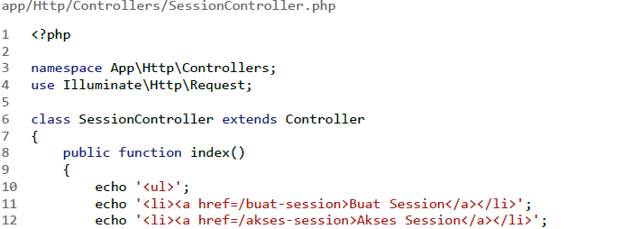
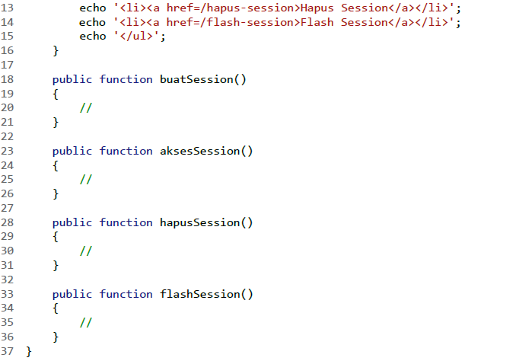
Early Preparations
Fig 1. SessionController.

Slide 6
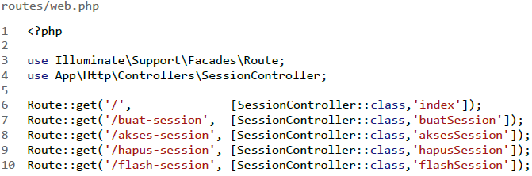
Early Preparations
SessionController has 5 methods. The index() method contains a 6-line echo command to create a list containing links to 4 other pages.
Four other methods will be created in stages, namely buatSession(), aksesSession(), hapusSession(), and flashSession(). As the name implies, these methods are used to create, access, delete, and access flash sessions.
Next you have to create a route like this:
Fig 2. Route for Session

Slide 7
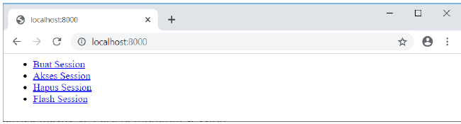
Early Preparations
The route accesses the five methods of the previous SessionController. Please access the localhost:8000 page to see the results:
Fig 3. Home http://localhost:8000

Slide 8
Create a Session
There are 3 ways to create a session in Laravel, including:
Using function helper session(<session_name>,<session_value>).
Via the $request->session()->put(<session_name>,<session_value>) method of the Request object.
Via the Session::put(<session_name>,<session_value>) method of the Session facade.
For the first method, namely from the session() function, we can directly write it into the controller:
1 public function buatSession()
2 {
3 session(['hakAkses' => 'admin']);
4 }

Slide 9
Create a Session
The second way is through the Request object, so we have to write the type hint Request $request as the method argument:
The third way is to use the Session::put() facade, so we also have to add the import use Illuminate\Support\Facades\Session command at the top of the controller:
1 public function buatSession(Request $request)
2 {
3 $request->session()->put('hakAkses','admin');
4 }
1 ...
2 use Illuminate\Support\Facades\Session;
3
4 public function buatSession()
5 {
6 Session::put('hakAkses','admin');
7 }

Slide 10
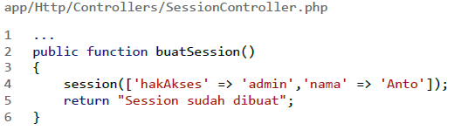
Create a Session
If we want to create several sessions at once, it can be written in the form of an array:
In this topic, we will use the first method to create a session.
-> session(['hakAkses' => 'admin','nama' => 'Anto']);
-> $request->session()->put(['hakAkses' => 'admin','nama' => 'Anto']);
-> Session::put(['hakAkses' => 'admin','nama' => 'Anto']);
Fig 4. Create Session in Controller

Slide 11
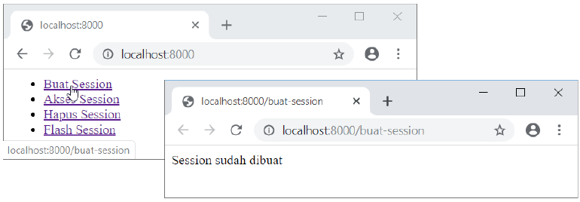
Create a Session
Please access the address localhost:8000/buat-session in a web browser or open it from the link on the previous root page:
Fig 5. Create Session

Slide 12
Reading Session
The session reading process can also be done in several ways :
Using function helper session(<session_name>).
Via the $request->session()->get(<session_name>) method of the Request object.
Via Session::get(<session_name>) method of Session facade.
Here's how to access the two sessions that we created earlier in Figure 6.

Slide 13
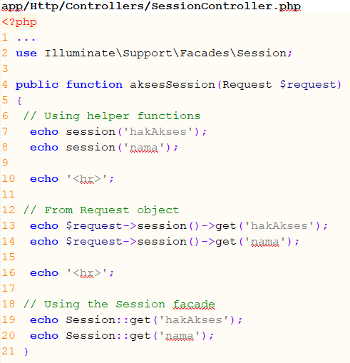
Reading Session
Fig 6. Controller Create Session

Slide 14
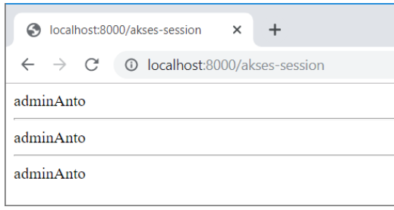
Reading Session
Fig 7. Result Reading Session

Slide 15
Deleting the Session
To delete a session can also be done in 3 ways:
Using the session->forget(<session_name>) helper function.
Via the $request->session()->forget(<session_name>) method of the Request object.
Via the Session::forget(<session_name>) method of the Session facade.
The following is an example of applying these three methods in Figure 8:

Slide 16
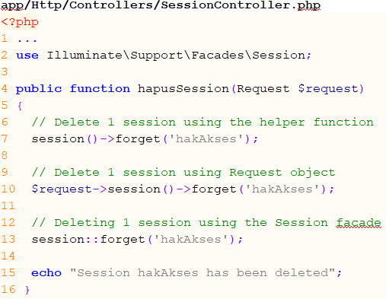
Deleting the Session
Fig 8. Controller Delete Session

Slide 17
Flash Session
Flash session is a term for a session that can only be accessed once, after that the contents are immediately deleted.
To create a flash session, you can also do the following 3 ways:
Using function helper session()->flash(<session_name>,<session_value>)
Via the $request->session()->flash(<session_name>,<session_value>) method of Request object
Via Session::flash(<session_name>,<session_value>) method of Session facade

Slide 18
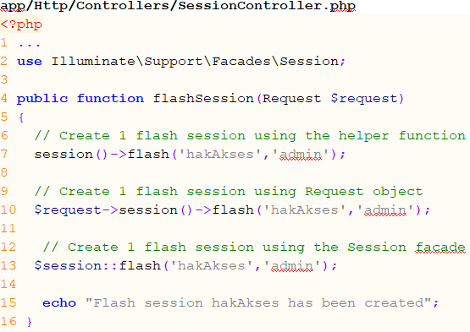
Flash Session
The following is an example of applying these three methods in Figure 9:
Fig 9. Controller Flash Session

Slide 19
Understanding Middleware
Middleware is a special class that functions to filter HTTP requests from web browsers to our applications. Or in a simpler sense, middleware is program code that can interrupt every request for a web page.
The most suitable implementation of middleware is for authentication, namely the process of user login and logout. In general, we encounter a page that can only be accessed if the user has logged in first. If not, then the user will be redirected to the login form. After logging in, then the page can be accessed again.

Slide 20
Early Preparations
When creating Middleware, we need preparation in the form of routes and controllers.
For the controller, we will return to using the MahasiswaController which can be created with the following command:
The following are some of the methods required by the controller shown in Figure 10.
php artisan make:controller MahasiswaController

Slide 21
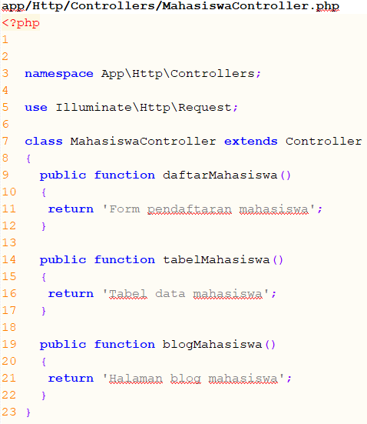
Early Preparations
Fig 10. Controller Middleware

Slide 22
Early Preparations
And here is the route to access the three methods in Fig 10:
Please open the page localhost:8000/daftar-mahasiswa, localhost:8000/tabel-mahasiswa and localhost:8000/blog-mahasiswa
routes/web.php
1 <?php
2
3 use Illuminate\Support\Facades\Route;
4 use App\Http\Controllers\MahasiswaController;
5
6 Route::get('/daftar-mahasiswa',[MahasiswaController::class,'daftarMahasiswa']);
7 Route::get('/tabel-mahasiswa', [MahasiswaController::class,'tabelMahasiswa']);
8 Route::get('/blog-mahasiswa', [MahasiswaController::class,'blogMahasiswa']);

Slide 23
Creating Middleware
Middleware is basically a PHP file. To create middleware, you can use the php artisan command with the following format:
The middleware will be in the form of a PHP class, so we recommend using PascalCase (capital letters at the beginning of each word). The middleware name should reflect the function of the middleware.
In this example create a middleware named CobaMiddleware:
php artisan make:middleware <NameMiddleware>

Slide 24
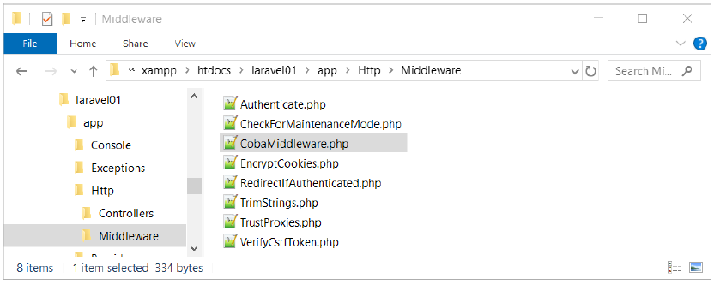
Creating Middleware
The Middleware file will be in the app\Http\Middleware\ folder, please open this folder:
Fig 11. Content of folder app\Http\Middleware\

Slide 25
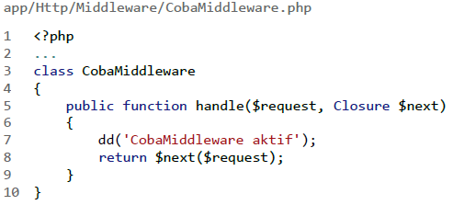
Creating Middleware
In the CobaMiddleware.php file, please add the command dd('CobaMiddleware aktif').
Fig 12. Controller CobaMiddleware

Slide 26
Creating Middleware
The return $next($request) command means that this middleware will continue to process the next request. So if we want to interrupt the request flow, write it before this line with the command dd('TryMiddleware aktif'):
With this addition, all pages implementing CobaMiddleware will display the text "TryingMiddleware is active" and because dd() contains a die() command, subsequent requests will no longer be executed.

Slide 27
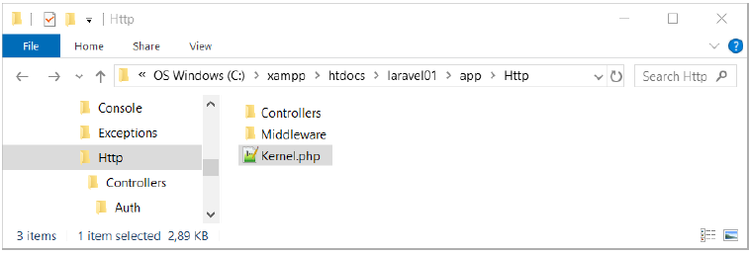
Registering Middleware
The middleware that we just created is not activated immediately, but must be registered first in the app\Http\Kernel.php file:
Please open the kernel.php file
Fig 13. File Kernel.php in folder app\Http\Kernel.php

Slide 28
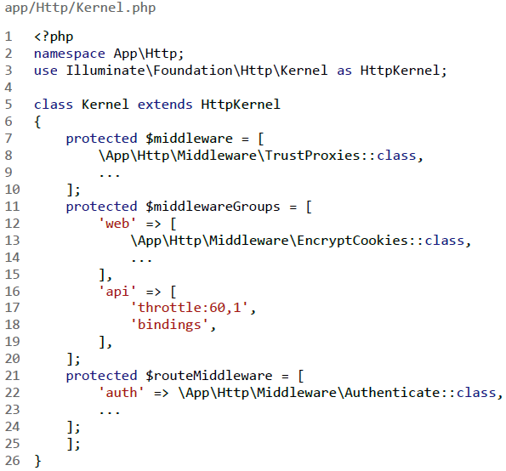
Registering Middleware
Fig 14. File Kernel.php

Slide 29
Registering Middleware
In line 5 there is a command to create a Kernel class that extends from the HttpKernel class. Our main focus is on these 4 property classes, namely: $middleware,$middlewareGroups, $routeMiddleware and $middlewarePriority. All of these properties are set with protected permissions
Each property contains an array of middleware classes, described as follows:
$middleware: Contains a list of global middleware that is always active for each request.
$middlewareGroups: Lists active middleware per-group. By default there are 2 groups, namely 'web' and 'api'. All middleware in the 'web' group will run when there is a request from a web browser.
$routeMiddleware: Contains a list of optional middleware that are active for certain routes only. Generally this is where we will register the created middleware

Slide 30
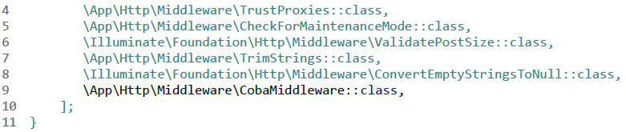
Registering Middleware
First, please add the CobaMiddleware class to the $middleware property:
The $middleware property itself is a place to register global middleware, namely middleware that is always active for every request. Please access one of the routes that we have prepared, for example localhost:8000/List-mahasiswa.
Fig 15. CobaMiddleware class in $middleware property

Slide 31
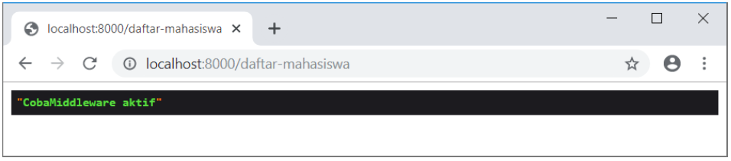
Registering Middleware
The result will display the text “CobaMiddleware is active", which comes from the dd() function in the CobaMiddleware class. This applies to all routes in Laravel.
Fig 16. CobaMiddleware already active

Slide 32
Enabling Middleware
In the previous practice, the CobaMiddleware middleware was already running but only as global middleware. This time we will discuss how to enable middleware for certain routes only. The condition is that the middleware must be registered first into the $routeMiddleware property as we have done
There are 2 ways to activate the middleware, namely from the route and from the controller.
But in this material, it will be taught to activate Middleware from Route.

Slide 33
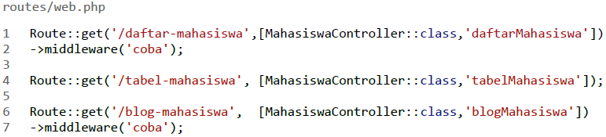
Enabling Middleware
Enabling Middleware from Route
To enable middleware from a route, you can chain the middleware('<key_name>') method into the route, as in the following example:
Fig 17. Enabling Middleware from route

Slide 34
Enabling Middleware
Enabling Middleware from Route
Here we enable CobaMiddleware into the '/daftar-mahasiswa' and '/blog-mahasiswa' routes. The 'coba' key is the key we wrote when registering the middleware to the $routeMiddleware property.
As a result, when the localhost:8000/daftar-mahasiswa and localhost:8000/blog-mahasiswa pages are accessed, the text "CobaMiddleware aktif" will appear. However, the localhost:8000/tabel-mahasiswa page will appear normal because it is not set with the Cobamiddleware.

Slide 35
Redirect Middleware
In the previous practice we have successfully run CobaMiddleware. But the results are just text only. Usually, this middleware will redirect the user to another page if a condition is not met.
These conditions can be designed according to needs, for example if the user has not logged in or the user does not have certain access rights.
For example, to create a middleware that will redirect users, this time we will modify CobaMiddleware to be as follows in Figure 18

Slide 36
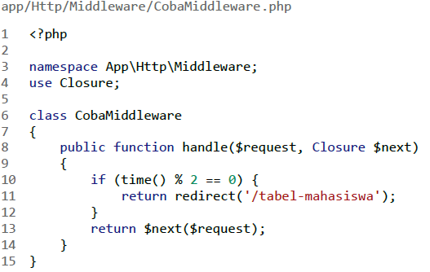
Redirect Middleware
Our main focus is on lines 10 – 12. Here we create a condition if (time() % 2 == 0). This condition will be true if the current second is divisible by 2, the result is that the web browser will be redirected to the /tabel-mahasiswa page.
Fig 18. CobaMiddleware.php

Slide 37
References
Lukmanul Hakim. (2020). Konsep & implementasi Pemrograman LARAVEL 7 Edisi BEST PRACTICE. CV. LOKOMEDIA. Yogyakarta. ISBN: 978-602-6231-25. Chapter 14
Andre Pratama. (2019). Laravel Uncover. DuniaIlkom.
https://www.youtube.com/watch?v=idw3k9EvmcE
https://www.youtube.com/watch?v=O0r7eQRZO3I

Slide 38
Thank You

